Slide 1
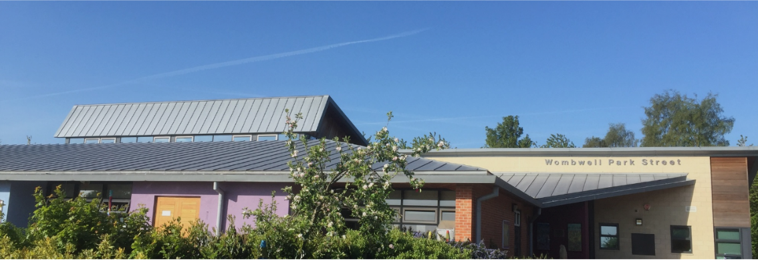
MATHS
Place Value | 1. I can count in steps of 2,3 and 5 from 0 forwards and backwards.
 | 2. I can count in tens from any number, forward and backward.
 | 3. I know the value of each digit in a two-digit number (tens, ones)
 | 4. I have an understanding of place value and can make statements about the values of digits compared to each other and write number statements …. such as 40 + ? = 70 or 35 < 53 and 42 > 36
 | 5. I can read and write numbers to at least 100 in numerals
Addition and Subtraction | 6. I can use place value and number facts to solve problems.
 | 7. I can recall and use addition and subtraction facts to 20 fluently
 | I can add and subtract numbers using concrete objects, pictorial representations, and mentally, including: | 8.a. adding three one-digit numbers
 |  | 8.b. a two-digit number and ones
 |  | 8.c. a two-digit number and tens
 |  | 8.d. two two-digit numbers (when no regrouping is required)
 | 8. I can recognise and use the inverse relationship between addition and subtraction
 | 9. Solve problems by applying their mathematics in a range of context: 10. I can use the inverse operation to check calculations and solve missing number problems for addition and subtraction
Multiplication and Division | 11. I can recall the multiplication and division facts for the 2, 5 and 10 multiplication tables
 | 13.I can use the multiplication and division facts for the 2, 5 and 10 multiplication tables demonstrating an understanding of commutativity as necessary
 | 14. Solve problems by applying their mathematics in a range of context: I can solve problems involving multiplication, using materials, arrays, repeated addition, mental methods, and multiplication and division facts, including when the calculation is within a problem.
Fractions Decimals | 15. I can recognise and name fractions 1/3, ½, 2/4, 3/4 as equivalent parts of a length, shape, set of objects or quantity
 | 16. I can find and write fractions ¼ ¾ 1/3, ½, 2/4, of a length, shape, set of objects or quantity
Measurement | 17. I understand and can find the mass of an object to the nearest appropriate unit, (kg/g) using scales
 | 18. I understand and can read a temperature scale to the nearest appropriate unit (°C) using thermometers
 | 19. I understand and can find the capacity (litres/ml) of a container to the nearest appropriate unit using a measuring vessels
 | 20. Read scales in divisions of 1’s 2’s 5’s 10’s in a practical situation where all the numbers on scales are given
 | 21. I can find different combinations of coins that equal the same amounts of money
 | 22. I can read the time to o’clock, half past, quarter past/to the hour and draw the hands on a clock face
Shape | 23. I can name and describe the properties of 2-D shapes, including the number of sides and line symmetry in a vertical line
 | 24. I can identify and describe the properties of 3-D shapes, including the number of edges, vertices and faces
Wombwell Park Street
Primary School
Working at the
Expected Standard
Year 2

Slide 2
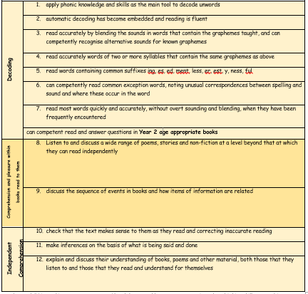
READING
WRITING
Each child must be able to meet these standards across a wide range of genre i.e. story, description, recount, report etc…
Punctuation | • marking most sentences with: | 1. capital letters and full stops
 | •and with some use of | 2. question marks
 |  | 3. exclamation marks
Sentences | •using sentences with different forms in their writing: | 4. statements
 |  | 5. questions
 |  | 6. exclamations
 |  | 7. commands
 | 8. using co-ordinating conjunctions (or / and / but)
 | 9. using some subordinating conjunctions (when / if / that / because)
Grammar | 10. using some expanded noun phrases to describe and specify e.g. use of adjectives
 | 11.using present and past tense mostly correctly and consistently
Spelling | 12. segmenting spoken words into phonemes (sounds) and representing these by graphemes (way sound is written), spelling many correctly
 | 13. spelling many common exception words
 | 14.. spelling some words with contracted forms e.g. I will = I’ll
 | 15. adding suffixes to spell some words correctly in their writing, e.g. –ment, –ness, –ful, –less, –ly *
Handwriting | 16. using the diagonal and horizontal strokes needed to join letters in some of their writing
 | 17. writing capital letters and digits of the correct size, shape and relationship to one another and to lower-case letters
 | 18. using spacing between words

