Slide 1
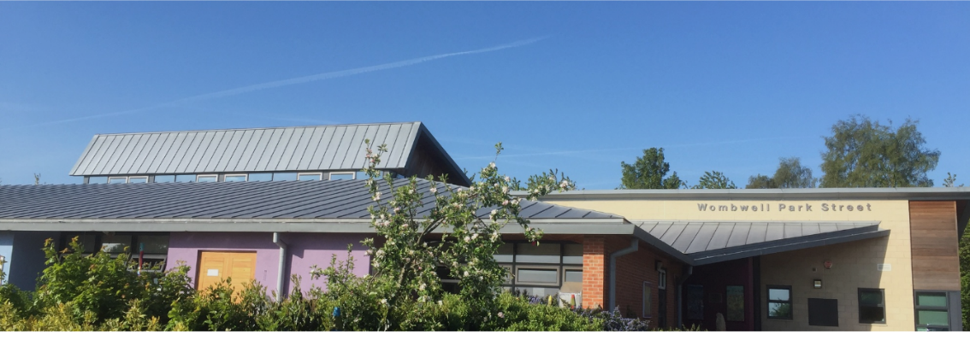
MATHS
Place Value | 1. I recognise the place value of each digit in a three-digit number (hundreds, tens, ones)
 | 2. I can order numbers and compare numbers up to 1000
 | 3. I can solve number problems involving place value; missing numbers and word problems
Addition and Subtraction | 4. I can add a three-digit number and ones mentally
 | 5. I can add a three-digit number and tens mentally
 | 6. I can add a three-digit number and hundreds mentally
 | 7. I can subtract a three-digit number and ones mentally
 | 8. I can subtract a three-digit number and tens mentally
 | 9. I can subtract a three-digit number and hundreds mentally
 | 10. I can add numbers from three digits, using formal written methods of column addition
 | 11. I can subtract numbers from three digits, using formal written methods of column subtraction
 | 12. I can solve problems with missing number problems
 | 13. I can solve problems using number facts and place value
 | 14. I can solve problems using more complex addition and subtraction.
Multi & Division | 15. I can recall/use multiplication and division facts for the 3 x 4x and 8x table
 | 16. I can calculate multiplication up to two-digit numbers times one-digit numbers
 | 17. I can calculate for division for two-digit numbers by one-digit numbers (with remainders)
 | 18. I can solve problems involving multiplication and division
Fractions | 19. I recognise, find and write fractions of a set of objects (with 1 or more as numerator and small denominators)
 | 20. I can add fractions with the same denominator within one whole
 | 21. I can subtract fractions with the same denominator within one whole
 | 22. I can solve problems with fractions
Measurement | 23. I can measure the perimeter of simple 2-D shapes
 | 24. I can add amounts of money using both £ and p
 | 25. I can subtract amounts of money to give change using £ and p
 | 26. I can tell and write the time from an analogue clock, including 12-hour and 24-hour clocks
Shape | 27. I recognise angles as a property of shape or a description of a turn
 | 28. I can identify right angles
 | 29. I can recognise that two right angles make a half-turn, three make three quarters of a turn and four a complete turn
 | 30. I can identify whether angles are greater than or less than a right angle
Wombwell Park Street
Primary School
Working at the
Expected Standard
Year 3

Slide 2
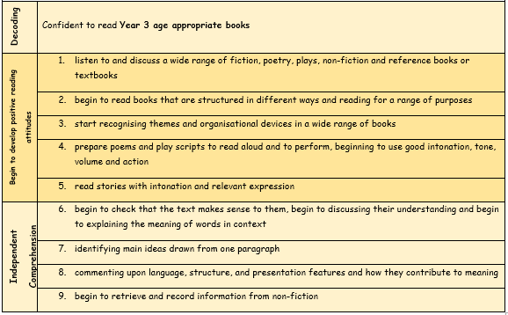
READING
WRITING
Each child must be able to meet these standards across a wide range of genre i.e. story, persuasion, recount, report etc…
Planning | 1. discuss writing similar to that which they are planning to write in order imitate its structure, vocabulary and grammar
 | 2. with discussion create settings, characters and plot
 | 3. start to organise paragraphs
Punctuation | • marking most sentences with: | 4. capital letters and full stops
 |  | 5. question marks
 |  | 6. exclamation marks
 | and with some use of: | 7. start using commas after fronted adverbials
 |  | 8. possession and the possessive apostrophe for regular plural nouns
 |  | 9. using and punctuating direct speech in independent writing
Sentences | 10. use a range of sentence structures (simple, compound and complex) | when
 |  | if
 |  | because
 |  | although
Grammar | 11. build a varied and rich vocabulary with use of adjectives, and adverbs expressing time, place and cause
 | 12. begin to use the present perfect form of verbs in contrast to the past tense (have eaten, have been eating)
 | 13. begin using fronted adverbials*
 | 14. start to choose nouns or pronouns appropriately to avoid repetition
 | 15. start to propose changes to grammar and vocabulary to improve consistency, including the accurate
Spelling | 16. spelling many common exception words
 | 17. begin to spell further homophones (words that sound the same)
 | 18. spelling of high frequency words (all year 1 and 2 and most of year 3)
 | 19 adding prefixes to spell some words correctly in their writing, e.g. un, dis, mis, re, super
 | 20. adding suffixes to spell some words correctly in their writing, e.g. er, ing, ly, ation
Handwriting | 21. using the diagonal and horizontal strokes needed to join letters
 | 22. understand which letters, when adjacent to one another, are best left unjoined

