Slide 1
Wombwell Park Street Primary School
Reading at Key Stage 2
Lead by: Chloe Baxter (KS2 Literacy Lead)

Slide 2
Agenda
Whole school approach to reading
YARC – A diagnostic assessment
Developing accuracy in a reader
Developing fluency in a reader
Developing comprehension in a reader
High quality texts to support reading into writing
Typical sequence and written output
Supporting reading at home
Resources

Slide 3
Whole School Approach to Reading
During EYFS and Key Stage 1 children spend time learning how to read through the use of Read Write inc.
Predominant focus is on accuracy and fluency.
Children are assessed half termly to check for progress.
When they enter Year 3 (Key Stage 2) the focus shifts. All children are baseline assessed using a system called YARC.
This checks the three strands of reading; accuracy, fluency and comprehension.
This enables appropriate support to be given to children based on needs.
The general pattern is most children are now ready for a reading diet more focussed around comprehension.

Slide 4
YARC – A diagnostic assessment
YARC diagnostic assessment comprised of fiction and non-fiction texts
Single Word Reading Test is used as a benchmarking test to instruct level children start reading at.
2 texts should be administered and timed
This is analysed to document children’s accuracy, reading rate and comprehension.
Where any children are working below age related expectations support and intervention will be implemented – this could be whole class, small group or 1:1 support.

Slide 5
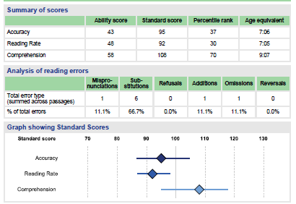
YARC – A diagnostic assessment

Slide 6
Developing accuracy in a reader
For some children they can read at speed and phrase appropriately but the accuracy of the words they are reading can be impacted.
BE SUPPORTIVE – Encourage and prompt children to take their time and carefully use their phonics to segment the word this is not a race – praise their efforts and use RWI language “Fred talk read the word”
BE PATIENT – Often we can want to make the correction for the child. Rather, allow them time and discuss strategies with them to enable them to reach the correct word themselves. E.g. chunking/word isolation
BE PERSISTANT – Ensure that you take the time in all reading sessions to recap those identified words they found tricky. This will support them in developing their fluency of the word over time and ensuring they are recognising challenging patterns etc regularly.
Also when a child has made inaccuracies, they need to re-read the sentence for sense with the correction.

Slide 7
Developing fluency in a reader
For some children, they can read words accurately but they may not always consider phrasing, pausing, intonation and speed when reading. This can hinder their understanding as they come on to develop comprehension.
Daily quick read of flashcard words to build confidence in reading words on sight.
Echo reading – there needs to be a model (what should effective reading aloud look like? Ensure they follow with their finger, match your pace and expression. Jump in reading – Adult reads to model and child follows with their eyes keeping pace. If adult pauses, then they need to jump in and carry on the rest of the sentence keeping pace.
Repeated reading of the same part (time trial of a sentence/paragraph/page – building speed of reading through repeated exposure and familiarity with words).
Emphasis on reading punctuation to prevent hindering meaning. Punctuation actions
Scooping reading – trying to deviate away from single word reading but instead phrasing.
Reading plays are excellent ways to develop understanding of intonation and expression when reading different parts.

Slide 8
Developing comprehension in a reader
Beyond fluency and accuracy some children may struggle to understand what they have read or what a question wants from them.
This can be supported in many ways:
Short summaries at the end of each paragraph to support in overall contextualisation
HOTS and VIPER questioning Note that children need to be able to SPEAK the answer before they can write it so verbal questioning is a great way to target development of these skills.

Slide 9
High quality texts to support reading into writing
This academic year we have reviewed the way we teach writing – we use high quality texts to support writing outcomes.
We delve deeper into these texts within reading to develop a clearer understanding of the genres, themes, plot and vocabulary.
This allows children to better understand what they are writing about and implement newly acquired language in context.
We also supplement the high quality text with additional extracts that may support the writing outcome e.g. When writing a newspaper linked to Fantastic Mr Fox children may access a non fiction newspaper article to help with structure and a text piece on Fox’s behaviour to support with discussing character traits.

Slide 10
How is reading taught to the class?
Monday – Vocabulary focus
Tuesday – Fluency focus
Wednesday – Comprehension focus
Thursday – Comprehension focus
Friday – comprehension focus

Slide 11
Typical sequence and written output
A typical weekly sequence would look as follows:
Reading model slides.notebook

Slide 12
Supporting reading at home
MODEL. MODEL. MODEL.
Provide a distraction free reading space – make it inviting and quality time with your child. When is your child most likely to engage?
Set challenges – Can they read so much in a certain time? Can you share the book and compete to do the best voice for a certain character? Can you tally who makes the least mistakes in reading?
Allow children to read around the text to develop meaning from what else is written down.
Use word wheels to develop deeper meaning of newly acquired language.
Once you have read a chapter/book storyboard to help children summarise what they have read and take away the main points.
Give them 3 events of the text and ask them to order them.
Make it fun – if they didn’t like the story can they rewrite the ending?

Slide 13
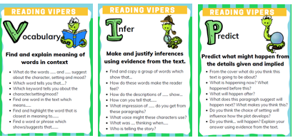
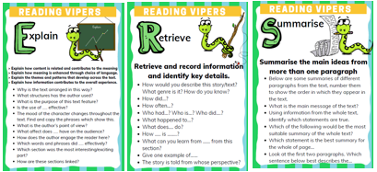
Resources
Might (Imagination)
Will (Prediction)
Would (Probability)
Can (Possibility)
Did (Past)
Is (Present)
 | What (Event) | When/Where (Situation) | Which (Choice) | Who (Person) | Why (Reason) | How (Means)

