Slide 1
Self Management

Slide 2
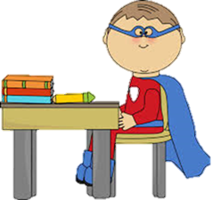
Hello everyone, I am Self Management Man.
It is my mission to make sure all children become brilliant at managing themselves and learn how to keep themselves safe.
Are you ready for a challenge?

Slide 3
What does good self management look like?

Slide 4
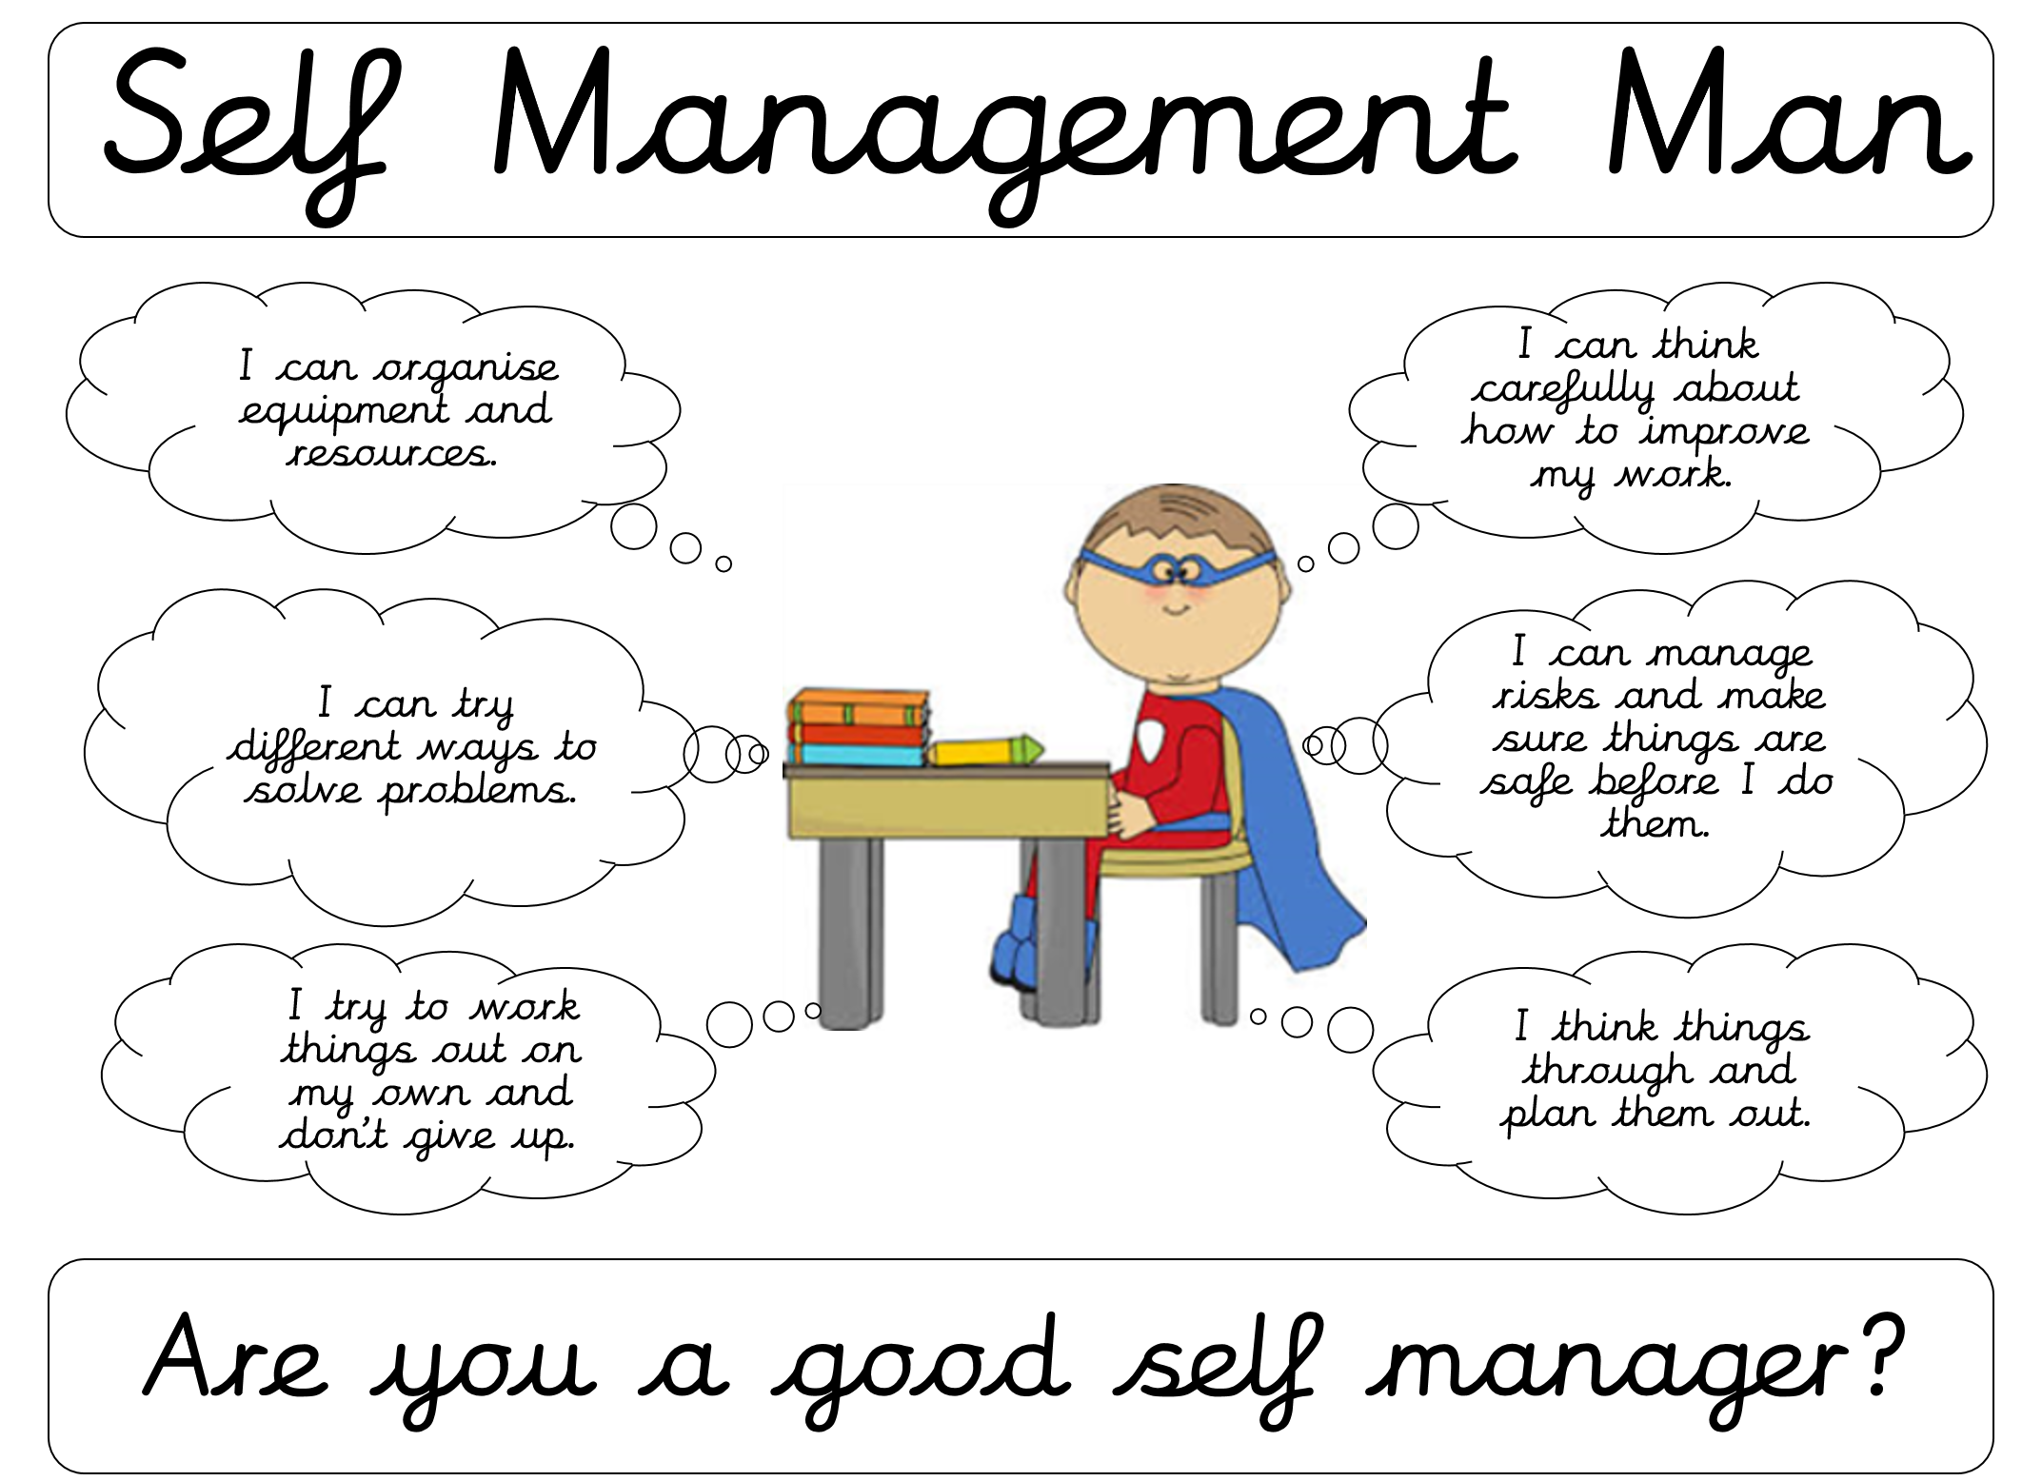

Slide 5
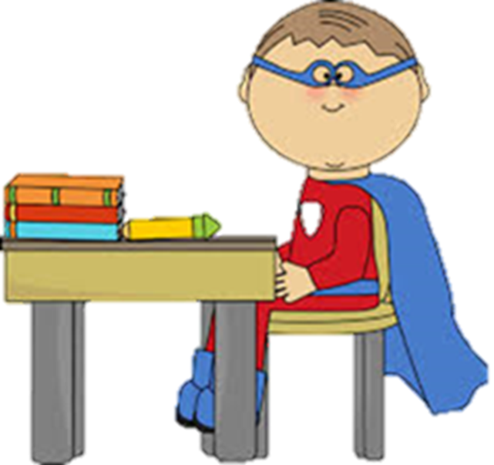
Are you ready for a challenge?

Slide 6
I’m feeling a little worried...
Miss Garratt has been working really hard to talk about the importance E-Safety but I don’t think the school knows enough about it.
We need to make sure everyone knows how to keep themselves safe when using technology.
It’s a key part of being able to manage risks.

Slide 7
Your challenge….
Can you help me to raise the profile of E-Safety in our school?
Come up with a new way of helping the children of Park Street understand what E-Safety is.
We will show these and display some of them in school and on the website.

Slide 8
Ideas for FS and KS1
Could you design a poster to promote E-Safety?
Draw, paint or make different types of technology. Talk about how we use them and how we can stay safe when using them.
Which emojis would we use if we are happy and safe using technology.

Slide 10
Ideas for KS2
Could you write a rap to help children remember about E-Safety?
Could you write a poem to help children remember E-Safety?
Could you come up with a list of top tips for keeping safe when using technology?
Could you design and make a E-Safety leaflet?
Could you apply your ICT skills and produce a presentation or video to promote E-Safety?
Write a story about using the internet using emojis instead of words.

Slide 13
I can’t wait to see what you come up with
Everyone that takes part will receive a certificate.
Please have your awesome ideas handed to your class teacher by
Friday 23rd February 2018

Slide 14
Best of luck and remember:
Self manage
Think about risks
Don’t give up

